Slide 1
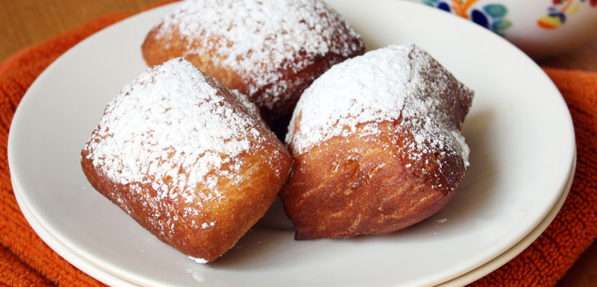

Ben-yay

Slide 2
A Very Chill Last Chance Canyon Figure

